Slide 1
Oracle certified Java associate
Andrei Dragutan

Slide 2
Wrapper classes

Slide 3

What is wrapper class?
Java defines a wrapper class for each primitive data type.
This is done in order to be able to use the primitive types as other classes

Slide 4
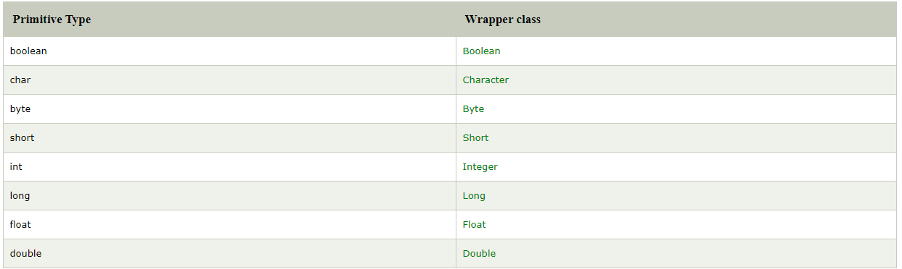
Wrapper classes in Java

Slide 5
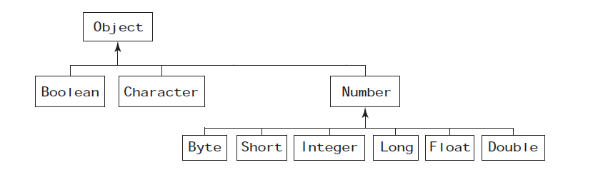
Wrapper class hierarchy

Slide 6
Creating an object of wrapper class
You can create an object of wrapper class by:
Assignment
Constructor
Static methods

Slide 7
Creating an object of wrapper class (Assignment)
Assigning a primitive value to the wrapper class reference variable.
Example:
Boolean boolObj = true;
Byte bt1 = 1;
Double = 10.98;

Slide 8
creating wrapper class references by assignment
Autoboxing

Slide 9
Creating an object of wrapper class (Constructor)
Calling the appropriate constructor of the wrapper class
Example:
Boolean bool = new Boolean(true);
Byte bt1 = new Byte(1);
Double = new Double(10.98);

Slide 10
Creating an object of wrapper class
(static methods)
Calling the valueOf() method of the wrapper classes.
Example:
Boolean bool = Boolean.valueOf(true);
Byte byteObj = Byte.valueOf(1);
Double dblObj = Double.valueOf(10.98);

Slide 11
Creating an object of wrapper class
(constructor vs static methods)
 | Constructor | Static method (valueOf)
Usage | new Boolean(true); new Integer(10); | Boolean.valueOf(“true”) Integer.valueOf(10)
Result | Always creates a new object. | Byte, Short, Integer, Long cache values from -128 → 127. Character caches values from 0 to 127. Float, Double do not cache any value.

Slide 12
Retrieving primitive value

Slide 13
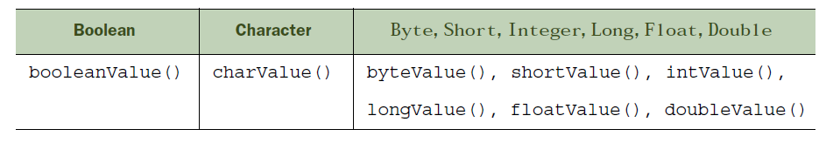
Retrieving primitive value
All wrapper classes define methods in format primitiveValue() where primitive is any primitive type.
Example:

Slide 14
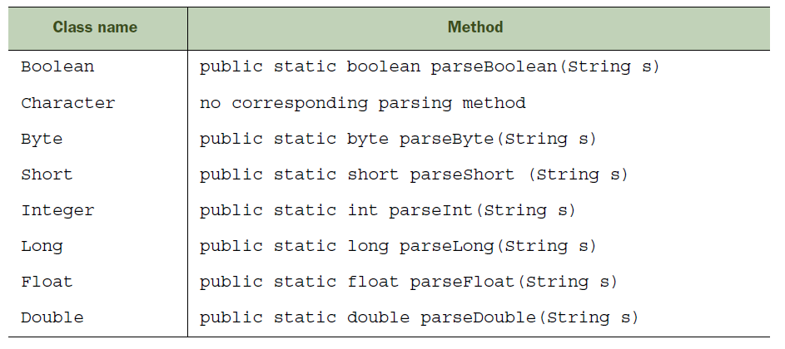
Parsing String into a primitive type

Slide 15
Parse invalid data
The parse methods throw errors if the supplied value is invalid.
Example:
byte wrong = Byte.parseByte(12566);
long wrongL = Long.parseLong(“12.45”)

Slide 16
Unboxing/Autoboxing

Slide 17
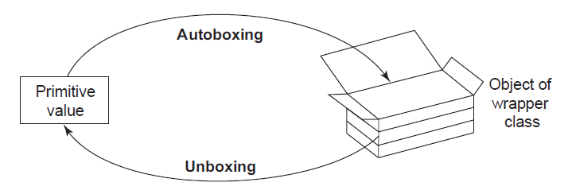
Difference between autoboxing/unboxing

Slide 18
Autoboxing
Automatic conversion from a primitive to an object of the corresponding wrapper class.

Slide 19
Unboxing
Automatic conversion from a an object of a wrapper class to the primitive value.

Slide 20
why do we need wrapper classes?

Slide 21
Need for wrapper classes
A lot of useful methods: compare, min, max, divide, etc.
Conversion from String → required type.
Use in code that is executed in multiple threads.

Slide 22
Practice: building our own desktop application
Define AWT and Swing
Know how to build a simple desktop application
Understand how to use GUI constructors

Slide 23
What is GUI?
GUI stands for Graphical User Interface
represents a compartment of applications that use graphical elements as interface for the element is opposite to command line applications.

Slide 24
GUI in Java
AWT - Abstract Window Toolkit
released in 1995
provides the look and feel of the underlying system
Swing
released in 1997
provides the Java look and feel on all the systems
JavaFX

Slide 25
Java FX
Released in 2008
Create applications with:
modern
high performance hardware accelerated user interface

Slide 26
AWT vs Swing
Swing replaced AWT
Swing has more components
Swing is slower
AWT uses native OS libraries
Swing looks the same on all the platforms
it can be personalized

Slide 27
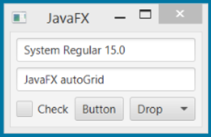
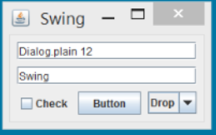
Java FX vs Swing
imagine: Kynosarges

Slide 28
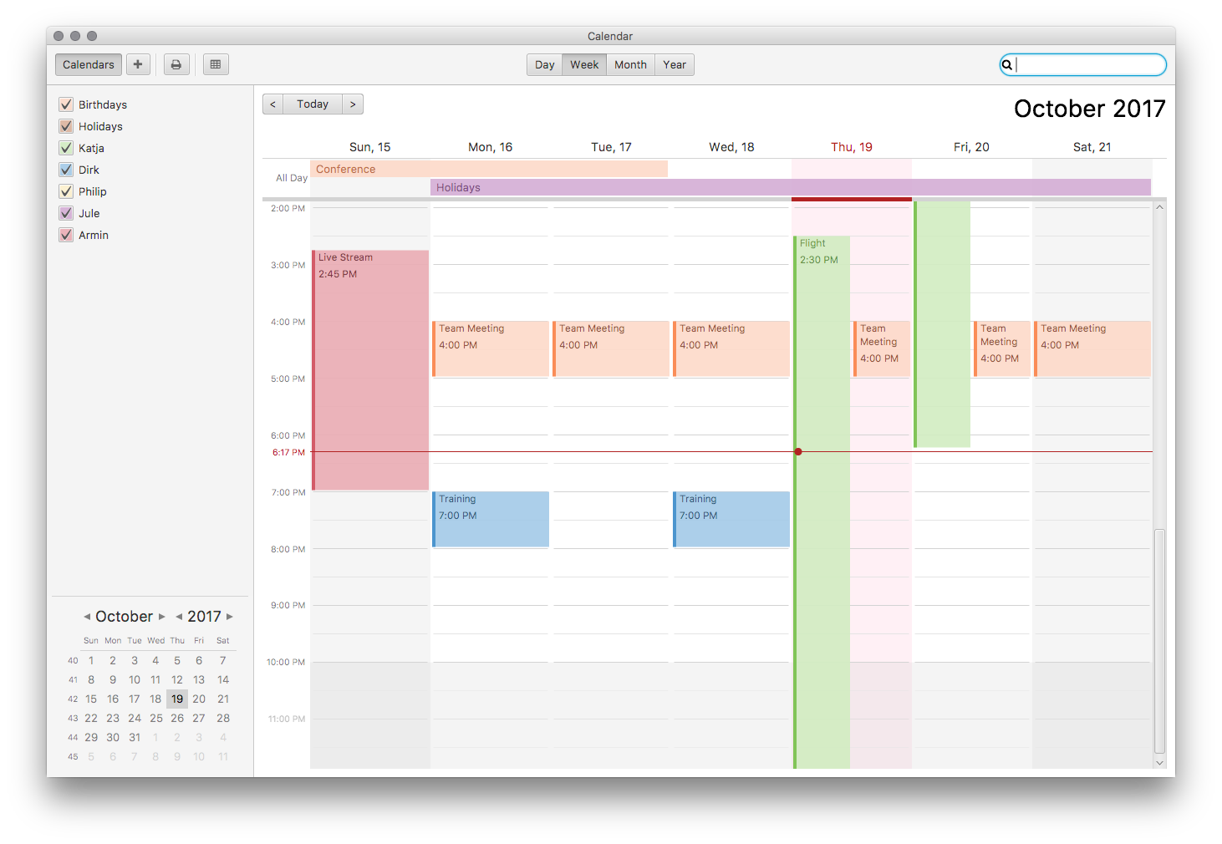
Java FX
imagine: https://github.com/dlemmermann/CalendarFX

Slide 29
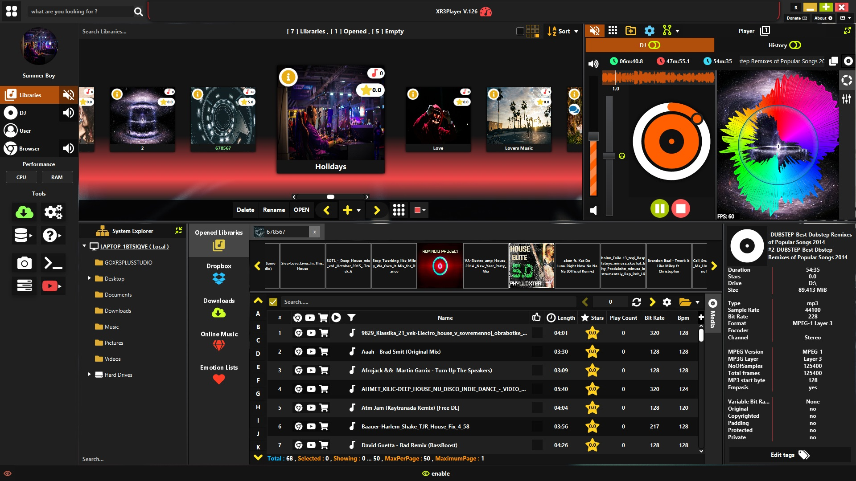
Java FX
imagine: https://github.com/goxr3plus/XR3Player

Slide 30
Creating first Java GUI app
JFrame f = new JFrame();//creating instance of JFrame
JButton b = new JButton("Hello");//creating instance of JButton
b.setBounds(130, 100, 100, 40);//x axis, y axis, width, height
f.add(b);//adding button in JFrame
f.setSize(400, 300);//400 width and 300 height
f.setLayout(null);//using no layout managers
f.setVisible(true);//making the frame visible

Slide 31
Example of swing classes
JFrame - root container of the application.
JPanel - sub component, added to the frame, used to group elements.
JLabel - regular text. Cannot be changed.
JTextField - input. Contains text that can be added dynamically.
JButton
JSeparator
JTable
JList
JRadioButton
JCheckbox
JSlider
...

Slide 32
ActionListeners
Every action that the user executes is an Event. Each event should have it’s own action listener.
The action listener is a special class* that is used to contain the code.
*ActionListener is not a class. We’ll get acquainted with what it is later.

